Slide 1
Chemistry In The Environment

Slide 2
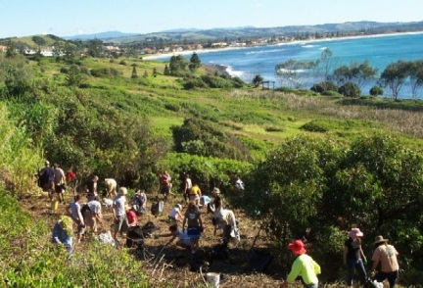
What is the environment?
The environment is all of our surroundings.
This includes the atmosphere, oceans, soil and all living things.

Slide 3
What are pollutants?
Our environment can be damaged by pollutants.
Pollutants are materials that can be toxic, can interfere with the food chain or change the rate of growth of species of animals and plants.
Pollutants can be in any physical state – solids, liquids or gases.
Even waste heat from a power station can be described as a pollutant.

Slide 4
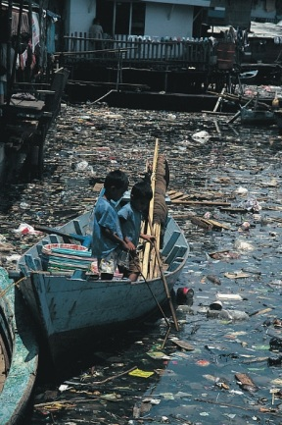
Pollutants

Slide 5
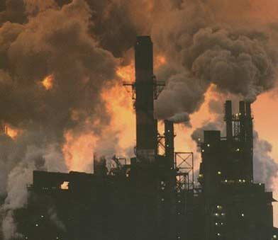
What is pollution?
Pollution is any damage to the environment that is caused by a pollutant.

Slide 6
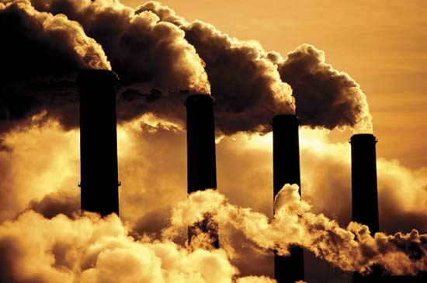
Sources of pollution
1. Burning of fossil fuels

Slide 7
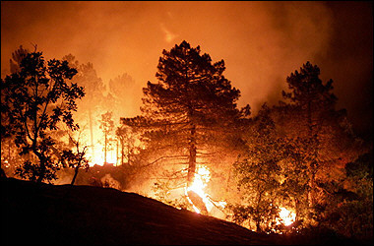
2. Land clearance by burning forests

Slide 8
3. Use of pesticides and fertilisers

Slide 9
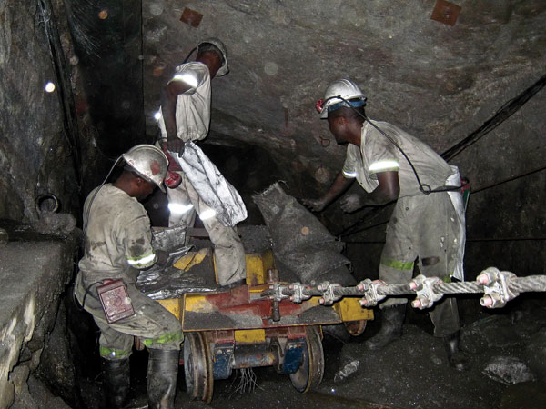
4. Waste materials from industrial processes such as mining, quarrying and smelting ores to make metals

Slide 10
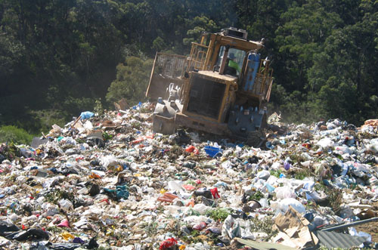
5. Disposal of plastic and other non-biodegradable waste materials

Slide 11
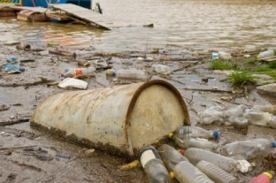
6. Sewage and other forms of water pollution

Slide 12
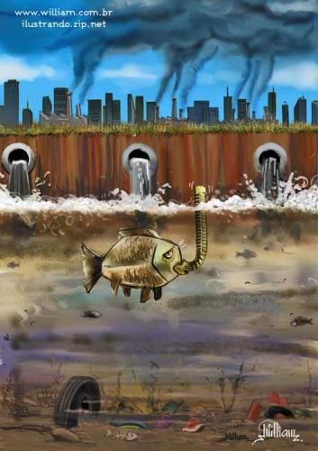
Activity: Identify three sources of pollution in the picture below and say how they can be prevented or managed.

Slide 13
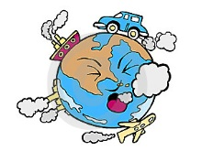
The Effects of Pollutants on the Environment

Slide 14
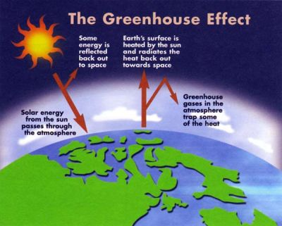
Effect 1: Global Warming – The ‘Greenhouse Effect’

Slide 15
Global Warming – The ‘Greenhouse Effect’
The absorption of infra-red radiation in this way is nothing new – it has always happened and is one of the processes which help to maintain the Earth at a temperature suitable for life.
The worry is that increased amounts of carbon dioxide caused by burning fossil fuels are upsetting the balance and causing unusually rapid increases in global temperatures.
Some things that are resulting from this are the melting of the polar ice caps, increased flooding and changes in the weather.

Slide 16
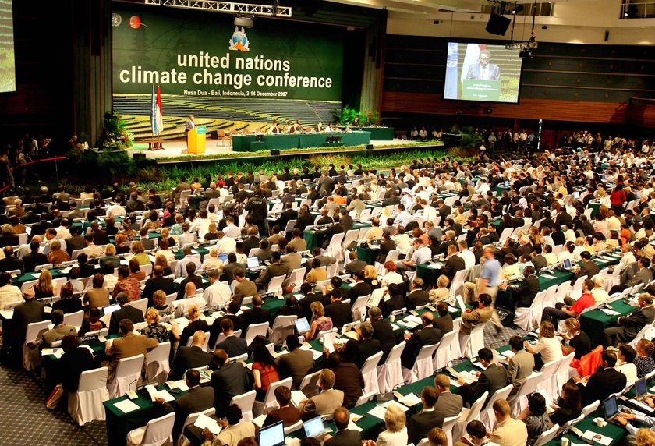
The Kyoto Protocol
The Kyoto Protocol is an agreement drawn up in 1997 in Japan by the United Nations to reduce the emission of greenhouse gases. Some 169 countries signed the agreement. The aim of the Kyoto Protocol is to reduce the effect greenhouse gases have on the climate.

Slide 17
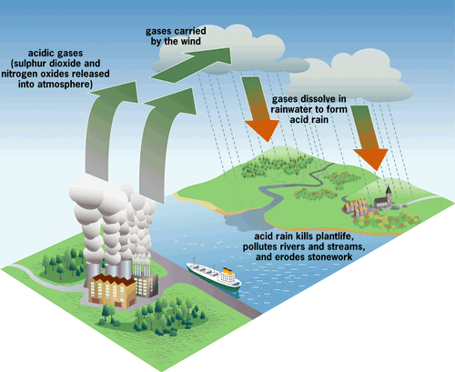
Effect 2: Acid Rain

Slide 18
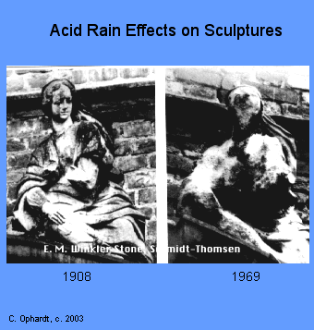
Acid Rain
Acid rain is acidic because of dissolved carbon dioxide.
Acid rain is even more acidic because of the presence of various pollutants.

Slide 19
How is acid rain caused?
Acid rain is caused when water and oxygen in the atmosphere react with sulphur dioxide to produce sulphuric acid, or with various oxides of nitrogen, NO_{x}, to give nitric acid.
These come mainly from power stations and factories burning fossil fuels, or from motor vehicles.
The high temperatures and pressures inside car engines make it possible for nitrogen and oxygen to react together. They form a mixture of nitrogen oxides which escape into the air from the exhaust pipe.

Slide 20
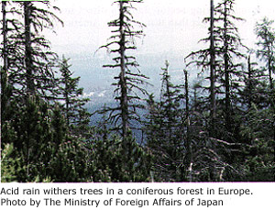
Why is acid rain worrying?
Acid rain is mainly worrying for its devastating effect on trees, and on life in lakes. In some areas, a high proportion of trees are affected and are either sick or dying. In some lakes the water is so acidic that it wont support life.

Slide 21
What is the solution to the acid rain problem?
Removing sulphur from fuels
‘Scrubbing’ the gases from power stations and factories to remove SO₂ and NO_{x}
Using catalytic converters in cars – helps to convert oxides of nitrogen into harmless nitrogen gas, but has no effect on sulphur dioxide

Slide 22
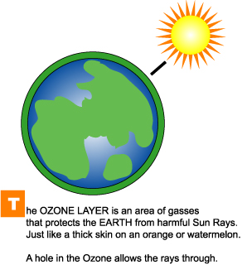
Effect 3: Ozone Layer Depletion

Slide 23
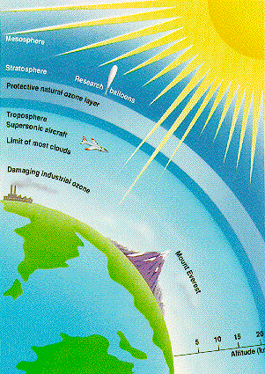
What is Ozone?
Ozone (O₃) is a gas found in the upper atmosphere which shields the Earth from dangerous ultraviolet (UV) rays.

Slide 24
How is the ozone layer depleted?
Chlorofluorocarbons (CFCs) are organic compounds containing carbon, chlorine and fluorine.
They have been used extensively in sprays as propellants and as coolants in refrigerators and air conditioners.
As CFCs do not dissolve in water or in the atmosphere, they accumulate in the atmosphere, where they break down the ozone molecules.

Slide 25
What happens when the ozone layer is depleted?
As the ozone layer becomes depleted, move UV light reaches the Earth.
As a result of this there has been a significant increase in the number of people developing skin cancer, cataracts and depressed immune systems.
It also adversely affects plant cells and lead to the death of aquatic organisms.
Depletion of the ozone layer is also contributing to the general increase in the word’s temperatures resulting in global warming.

Slide 26
Summary
In this lesson we learnt how to:
1. Define environment and pollution.
2. Identify common sources of pollution.
3. Explain the basic concepts of pollution prevention and conversion.
4. Explain the importance of water in the environment.

