Slide 1
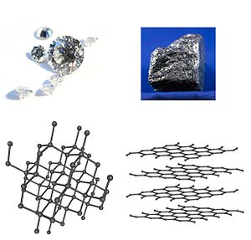
Allotropy

Slide 2
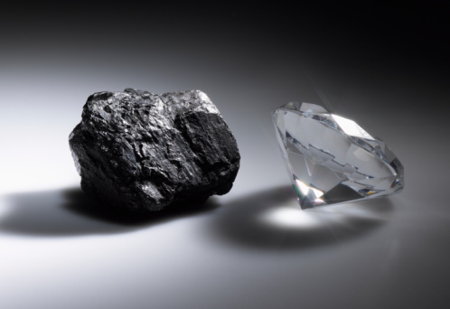
What is allotropy?
Some elements exist naturally in more than one form.
For example, carbon exists naturally as diamond and graphite.

Slide 3
The carbon atoms are arranged in different patterns inside the two materials. This gives them different properties.

Slide 4
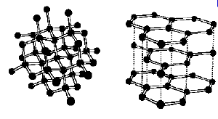
Diamond is the hardest natural material whereas its allotrope graphite is one of the softest.

Slide 5
Other Examples of Allotropes

Slide 6
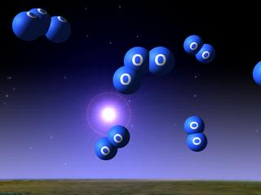
1. Allotropes of Oxygen
Oxygen, O₂, and ozone, O₃, are also allotropes. They are both gases.

Slide 7
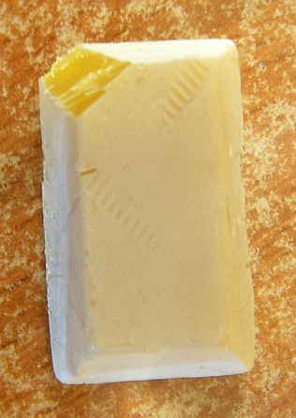
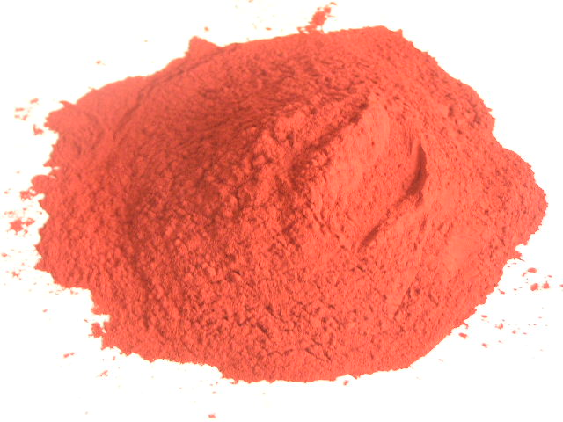
2. Allotropes of Phosphorus
White phosphorus and red phosphorus are allotropes of the element phosphorus.

Slide 8
Compare the two allotropes of phosphorus
Property | White Phosphorus | Red Phosphorus
Melting Point/ ºC | 44 | Sublimes at about 400ºC
Appearance | Yellow, waxy | Red, powdery
Solubility | Soluble in benzene | Insoluble
Structure | Simple molecular | Giant structure

Slide 9
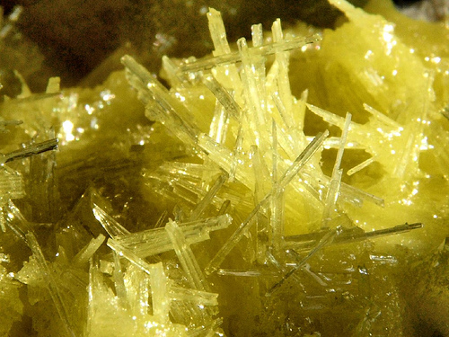
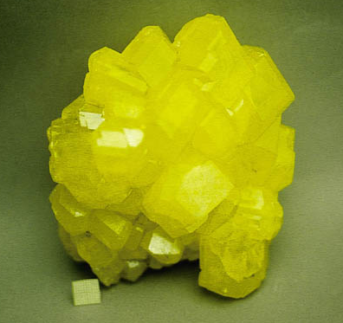
3. Allotropes of Sulphur
Sulphur is another element which exists as allotropes.

Slide 10
Allotropes of Sulphur
Sulphur can form needle-shaped crystals called monoclinic sulphur, or crystals which are like two pyramids joined base to base, called rhombic sulphur.

Slide 11
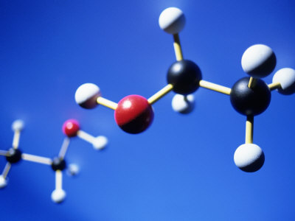
Properties of Simple Molecular Structures

Slide 12
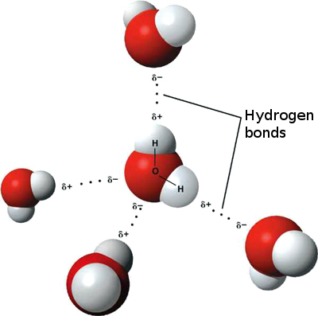
1. They tend to be gases, liquids or low melting point solids.
Remember that molecules contain fixed numbers of atoms joined by strong covalent bonds.
The forces of attraction between one molecule and its neighbours are much weaker than the covalent bonds, and vary in strength from compound to compound.

Slide 13
Because these intermolecular attractions are relatively weak, simple molecular compounds tend to be gases, liquids or low melting point solids.

Slide 14
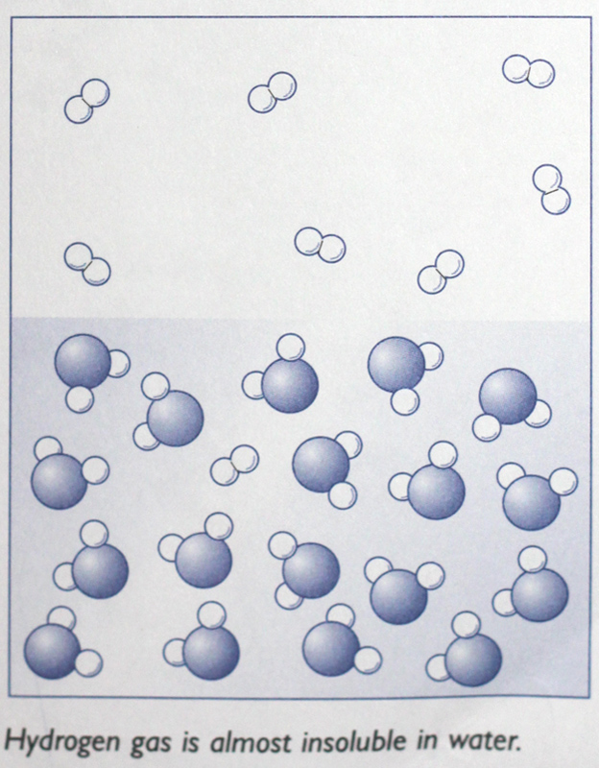
2. Molecular substances tend to be insoluble in water unless they react with it.
In order for a substance to dissolve, quite strong attractions between water molecules have to be broken so that the dissolving molecules can fit between them.

Slide 15
Any new attractions between water molecules and the covalent molecules are not usually big enough to compensate for this.

Slide 16
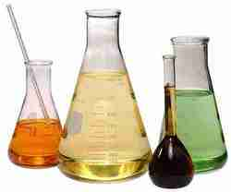
3. Molecular substances are often soluble in organic solvents.
In this case, the intermolecular attractions between the two different types of molecules are much the same as in the pure substances.

Slide 17
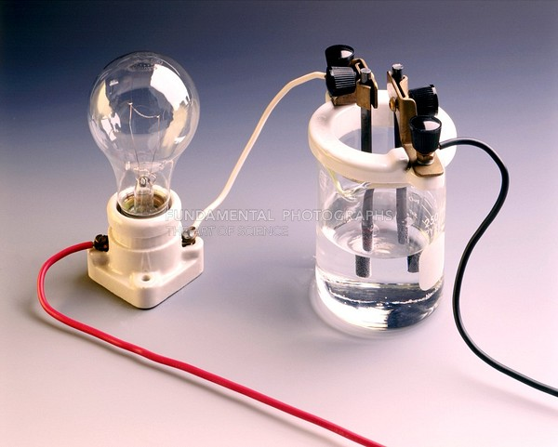
4. Molecular substances do not conduct electricity.
This is because the molecules do not have any overall electrical charge and there are no electrons mobile enough to move from molecule to molecule.

Slide 18
Summary
In this lesson we learnt about the following:
Allotropes
Structures of Diamond & Graphite
Properties of Simple Molecular Structures

