Slide 1
Giant Structures (continued)

Slide 2
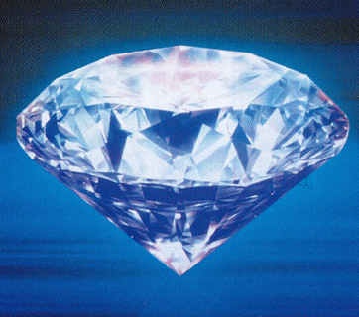
Diamond

Slide 3
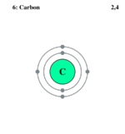
Diamond
Diamond is a form of pure carbon.
Each carbon atom has four unpaired electrons in its outer energy level (shell) and it uses these to form four covalent bonds.

Slide 4
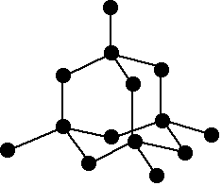
Bonding In Diamond
In diamond, each carbon bonds strongly to four other carbon atoms.
The diagram shows enough of the structure to see what is happening.

Slide 5
Activity: Look at the diagram. Is each carbon atom forming four bonds?
In the diagram some carbon atoms only seem to be forming two bonds (or even one bond), but that’s not really the case. The diagram is only showing a small bit of the whole structure.

Slide 6
The Covalent Bonds in Diamond
The lines in the diagram each represent a covalent bond.

Slide 7
Diamond is a Giant Covalent Structure
This is a giant covalent structure – it continues on and on in three dimensions.

Slide 8
Diamond is not a molecule
It is not a molecule, because the number of atoms joined up in a real diamond is completely variable, depending on the size of the crystal.
Molecules always contain fixed numbers of atoms joined by covalent bonds.

Slide 9
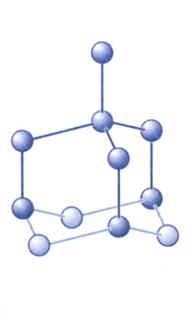
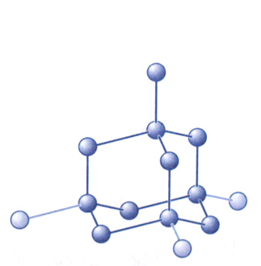
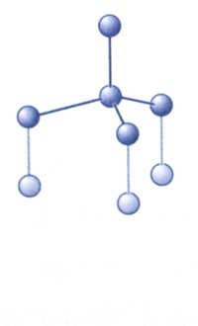
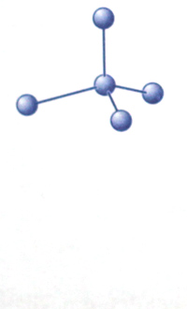
Activity: Drawing the structure of Diamond
Draw the structure of diamond using the stages shown below.

Slide 10
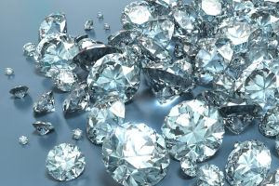
Properties of Diamond

Slide 11
1. Diamond is very hard, with very high melting and boiling points.
This is because of the very strong carbon-carbon covalent bonds which extend throughout the whole crystal in three dimensions.

Slide 12
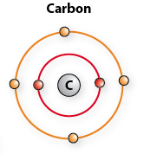
2. Diamond does not conduct electricity.
This is because all the electrons in the outer levels of the carbon atoms are tightly held in covalent bonds between the atoms. None are free to move around.

Slide 13
3. Diamond does not dissolve in water or any other solvent.
This is again because of the powerful covalent bonds between the carbon atoms. If the diamond dissolved, these would have to be broken.

Slide 14
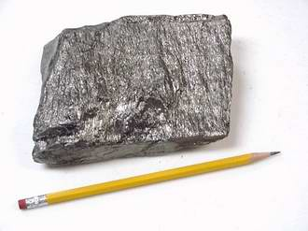
Graphite

Slide 15
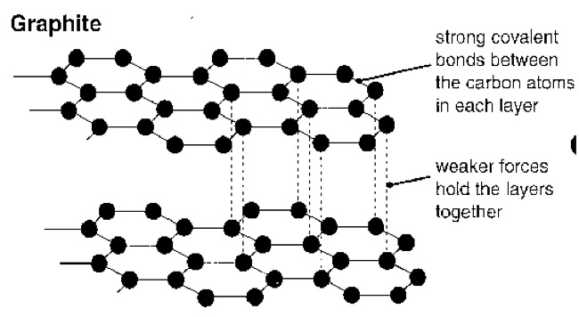
Graphite
Graphite is also another form of carbon, but the atoms are arranged differently.

Slide 16
Activity: Drawing the structure of Diamond
Draw the structure of graphite.

Slide 17
Structure of Graphite
Graphite has a layer structure rather like a pack of cards. In a pack of cards each card is strong, but the individual cards are easily separated. The same is true in graphite.

Slide 18
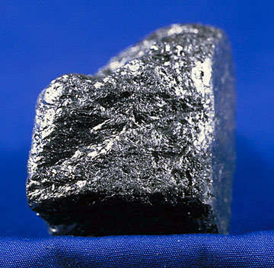
Properties of Graphite

Slide 19
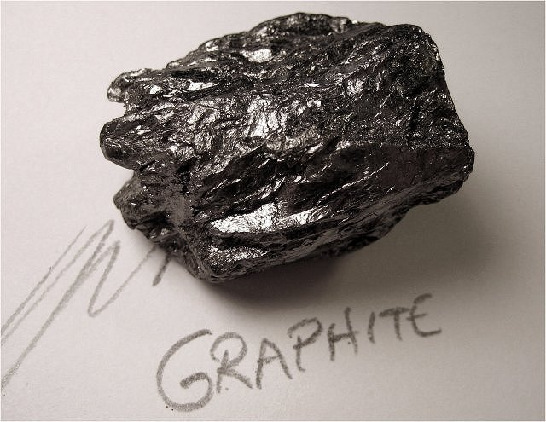
1. Graphite is a soft material with a slimy feel.
Although the forces holding the atoms together in each layer are very strong, the attractions between the layers are much weaker.
Layers can easily be flaked off.

Slide 20
Graphite (mixed with clay to make it harder) is used in pencils.
When you write with a pencil you are leaving a trail of graphite layers behind on the paper.

Slide 21
Pure graphite is so slippery that it is used as a dry lubricant – for example, to lubricate locks.

Slide 22
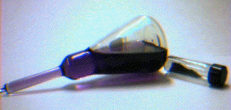
2. Graphite has High Melting and Boiling Points and is Insoluble in any Solvent.
To melt or dissolve the graphite, you don’t just have to break the layers apart – you have to break up the whole structure, including the covalent bonds.
This needs very large amounts of energy because the bonds are so strong.

Slide 23
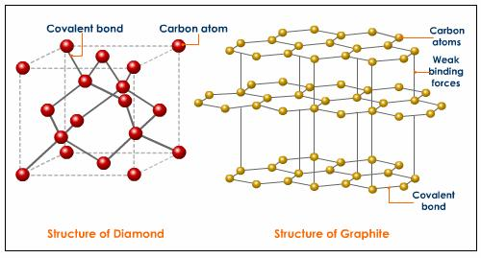
3. Graphite is less dense than diamond.
This is because the layers in graphite are relatively far apart.

Slide 24
The distance between the graphite layers is more than twice the distance between atoms in each layer.
In a sense, a graphite crystal contains a lot of wasted space, which isn’t there in a diamond crystal.

Slide 25
4. Graphite conducts electricity.
Look at the diagram of the arrangement of the atoms in each layer in the graphite.
Question: How many atoms is each carbon atom joined to?
Answer = 3

Slide 26
Each carbon atom uses three of its electrons to form these simple covalent bonds.
Question: How many electrons are therefore free?
Answer = 1

Slide 27
The fourth electron in the outer layer of each atom is free to move around throughout the whole of the layer.
The movement of these electrons allows the graphite to conduct electricity.

